Slide 1
Creating your first bot

Slide 2
What bots are NOT?

Slide 3
What bot are not?
Artificial Inteligence only
Bots can be simple tasks like:
Password Resetter
Alarm Setter
Stock Checker

Slide 4
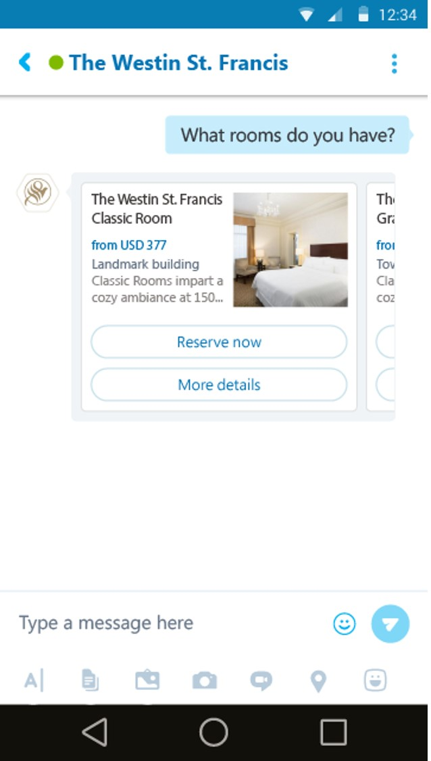
What bot are not?
Artificial Inteligence only
Text Interface only
Bots can receive/transmit Information without natural language
Example:
Buttons, Carrousel, Audio, Graphs

Slide 5
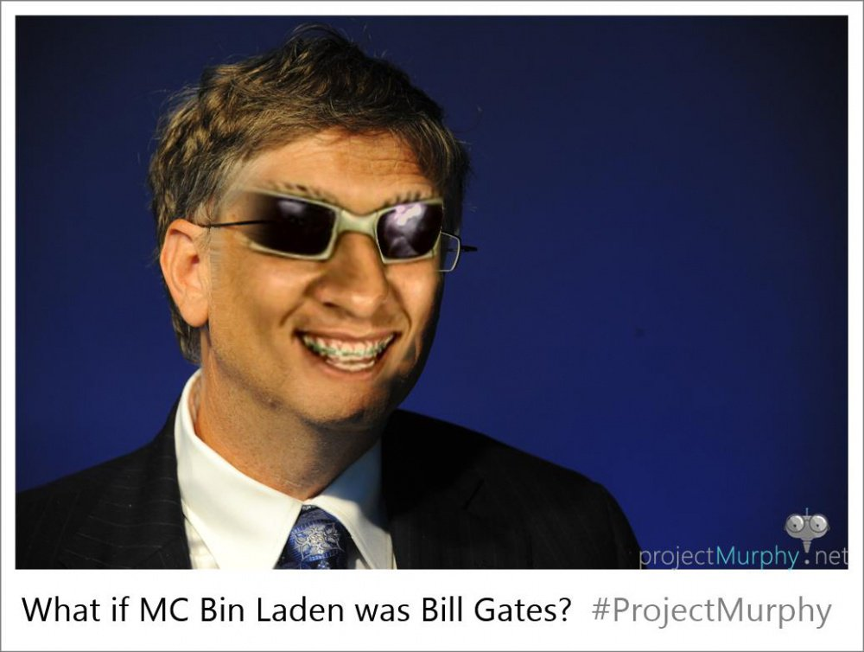
What bot are not?
Artificial Inteligence only
Text Interface only
Natual Language Process only

Slide 6
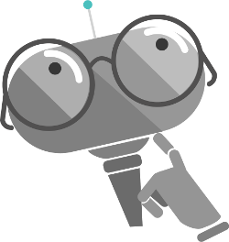
What bots are?
Apps with a new interface
Faster access
Avaiable across more platforms
Less friction to build and deploy
More Natural Interactions
+ Cognitive Services

Slide 7
Your First Bot

Slide 8
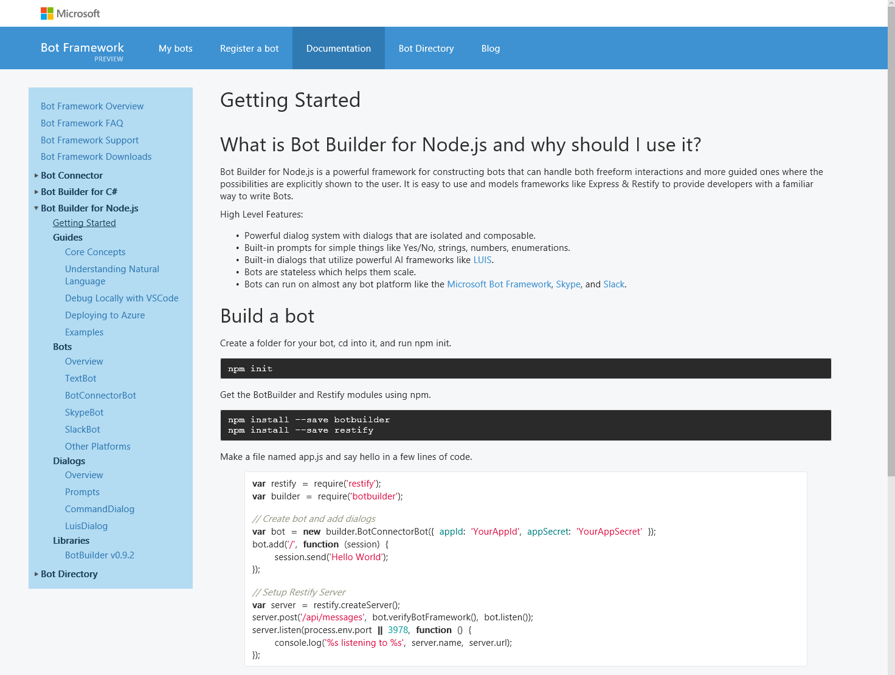
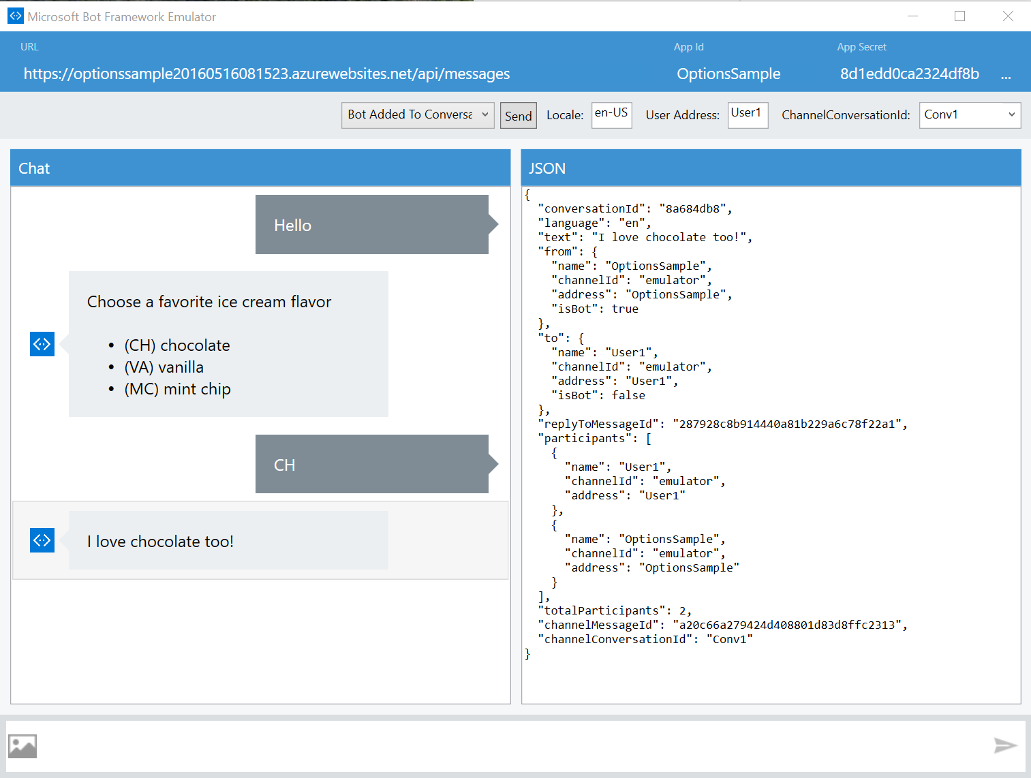
Bot Framework
Cognitive Services
Knowledge Cloud
Distribution Channels
Bot Development Tools
Build your bot with the best-in-class tools and services for bot development
Register and Manage your Bot
Build your Bot with the Bot Builder SDK
Test your Bot with the Bot Emulator
Deploy to Azure or other Cloud Service
Access Open Source Code and Guides
Microsoft Confidential

Slide 9
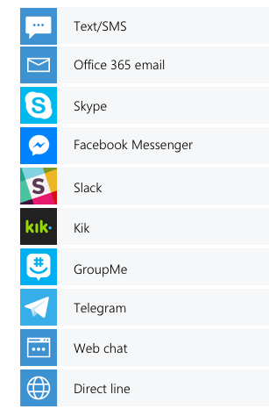
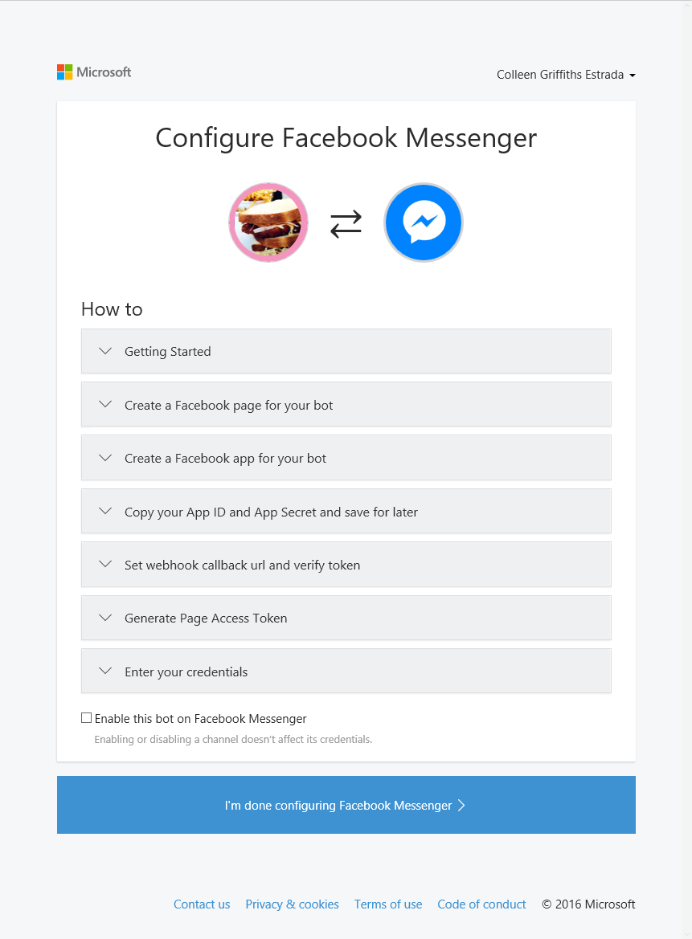
Bot Framework
Cognitive Services
Knowledge Cloud
Distribution Channels
Bot Connector
Connect your bot to the most popular messaging channels, including SMS/MMS and E-mail
Publish to 10+ Major Channels
Manage Channel Configuration
Use Built-in Interfaces for Channel I/O
Analyze Usage by Channel
Microsoft Confidential

Slide 10
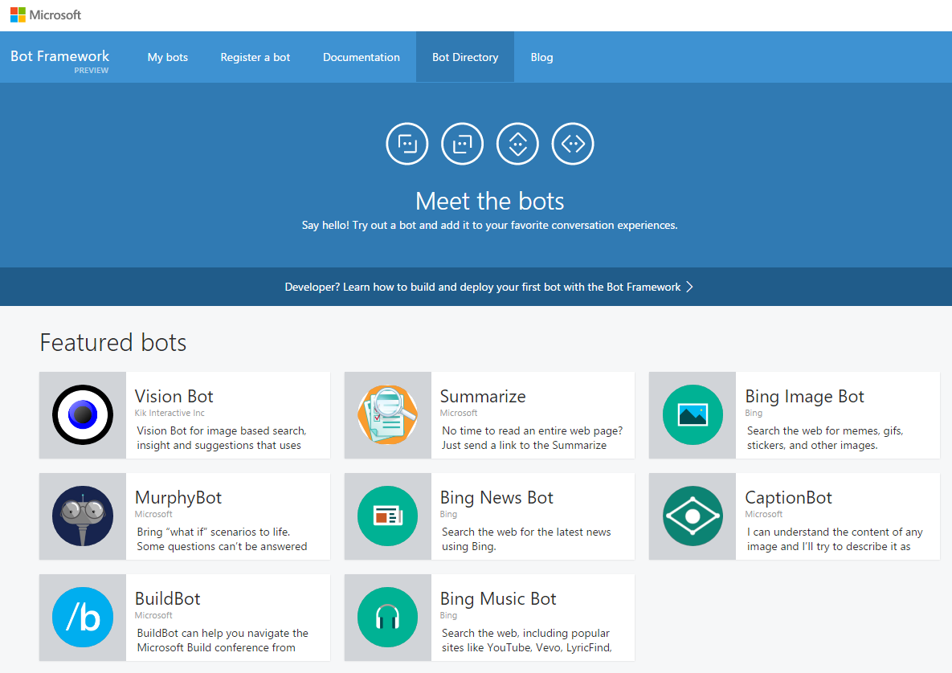

Bot Framework
Cognitive Services
Knowledge Cloud
Distribution Channels
Bot Directory
Make your bot discoverable to other users in Bing, Cortana, Skype and other Microsoft channels
Publish your Bot to the MS Directory
Expose your Bot through the MS Distribution Channels (Bing, Skype, etc.)
Connect your Bot to Cortana
Microsoft Confidential

Slide 11
Set Up
To install bot application, click here.
Install the bot application in Visual Studio folder, as “% USERPROFILE% \ Documents \ Visual Studio 2015 \ Templates \ ProjectTemplates \ Visual C # \”
You will need:
Visual Studio 2015
Bot Application

Slide 12
DEMO - Setting up

Slide 13
DEMO 1 - Creating your first bot using Visual Studio

Slide 14
DEMO 2 – Creating webapp to host your bot

Slide 15
DEMO 3 – Registering your bot at Bot Framework

Slide 16
DEMO 4 – Testing your bot

Slide 17
Thank you!
Microsoft Confidential

Slide 19
Appendix
Microsoft Confidential

